Slide 1
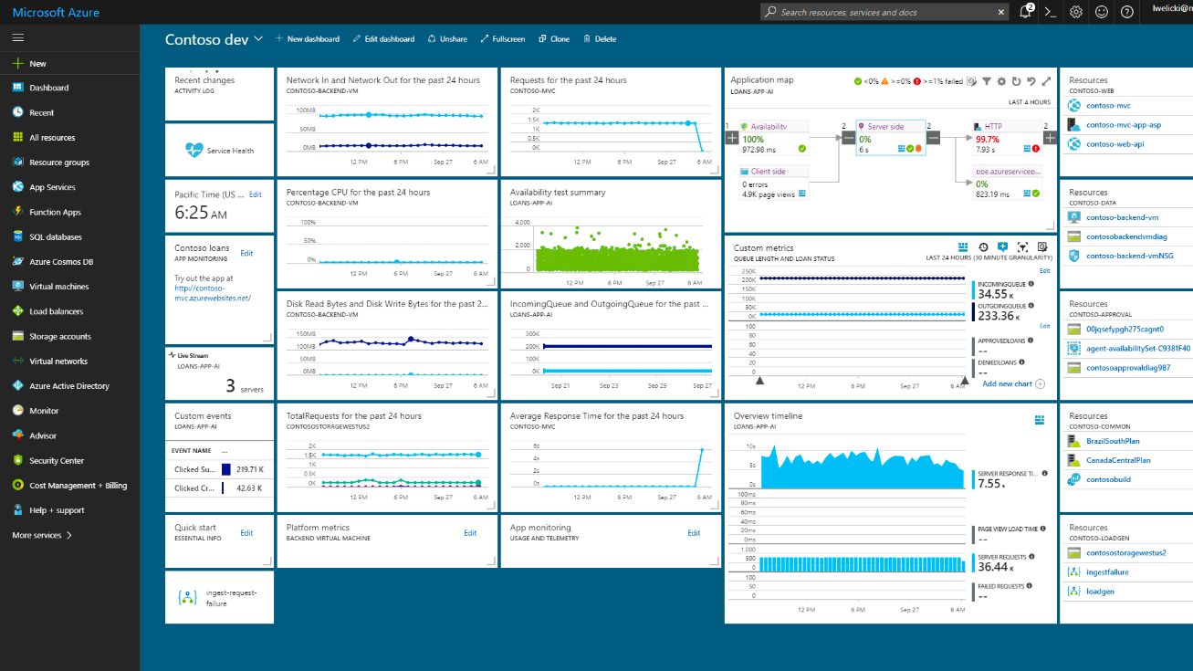
Azure Student Dev Day <insert school or location> <insert date>

Slide 2
<your name>
<your picture>
<your title>
@<your handle> on Twitter
Notes:
Hello. I’m []
//share a bit about yourself, why you love technology

Slide 3
Agenda
◻
Introduction to Cloud Computing and Microsoft Azure
Build with Azure App Services with GitHub
Experiment with Artificial Intelligence & Machine Learning
Connect with Microsoft during your student career
◻
◻
◻

Slide 4
Cloud: Massive power for everyone
Scalability
Massive available compute
Massive available datasets
Affordability
Scale up and down
No need to buy hardware
Flexibility
Use it only when you need it
Use your preferred platforms
Notes:
The cloud is democratizing the power of computing—that is, making it available for every creator, builder, and developer. It’s leveling the playing field. People like you now have the same power that was once available only to huge organizations with huge data centers and huge budgets.
Whether you build your first app or seek to uncover new insights from the human genome, the cloud gives you the power to scale up in processing power as far as you need to go, when you need it, and then to scale down to zero once your project is over.
For example, let’s say you’re building the digital Olympics experience, a website, mobile apps, live-streaming platforms, and real-time notifications—all that requires incredible scale, but only for the length of the games (one billion people will access it and want their 4K, 1080p content to “just work”). And then the games are done, and demand goes to zero almost overnight.
Cloud makes situations like that possible because you don’t have to own the massive computers behind the scenes or pay for them for a single minute longer than you need them, and you can access this computing power on your own schedule.
[No need to say the words on the slide, they are for emphasis—but feel free to ad-lib more scenarios, particularly local ones.]

Slide 5








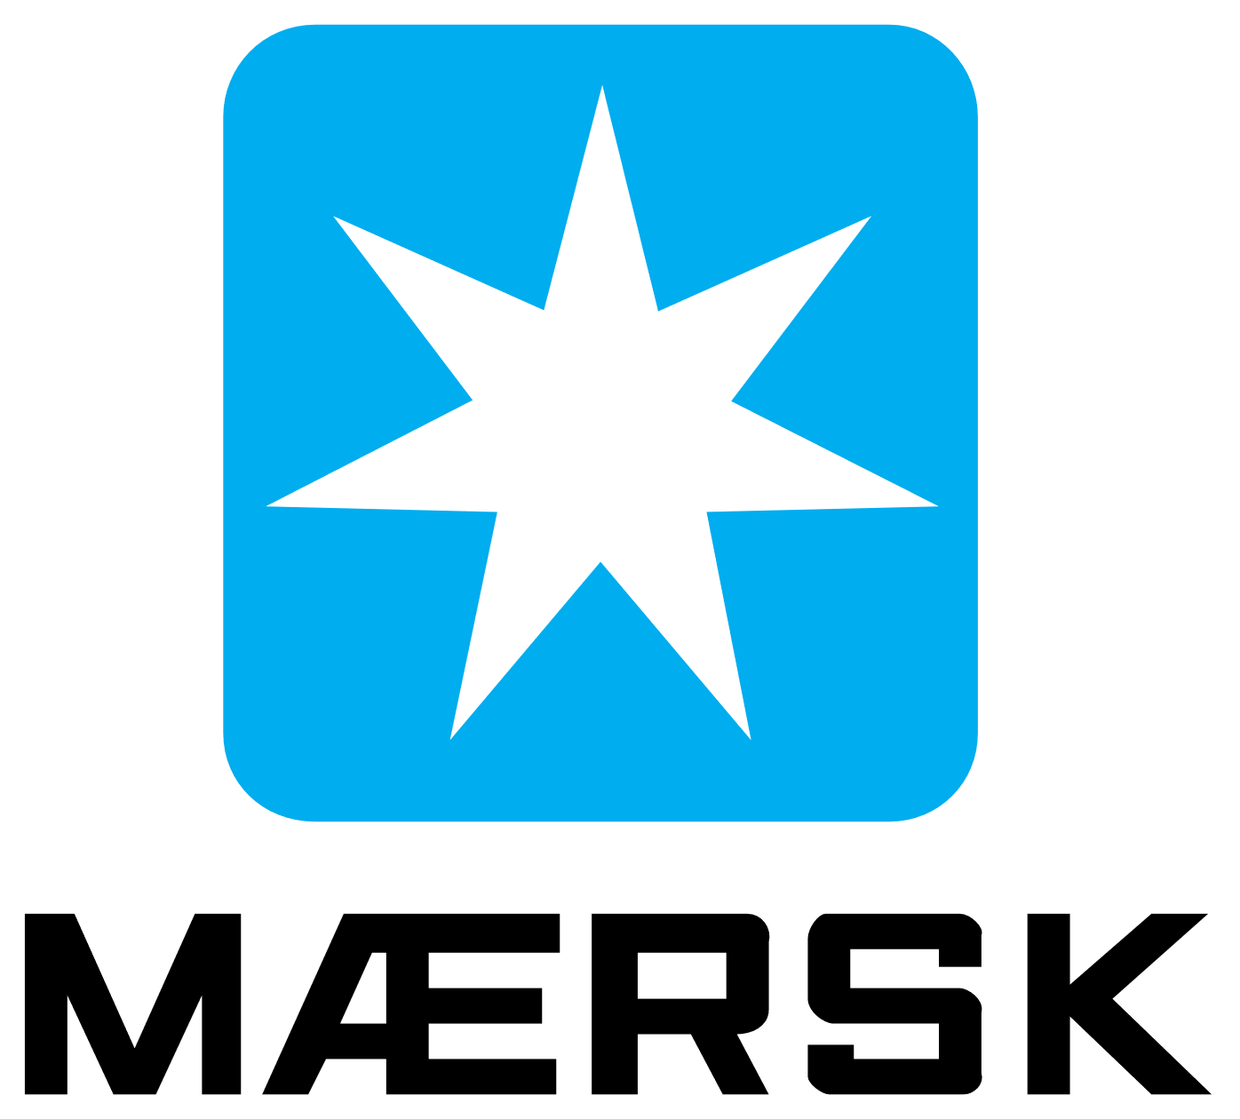












90%
of the Fortune 500 use Azure⁵
Notes:
Azure is a smart choice for your career. Some of you might choose to work for large companies, and chances are high that your company will use the cloud.
90% of the Fortune 500 use Azure.
//Quick point, no need to linger.
⁵ Microsoft. “Confidence in the trusted cloud.” https://azure.microsoft.com/en-us/overview/trusted-cloud/.

Slide 6
42
Azure regions⁶
Notes:
Some of the biggest apps in the world today, like Facebook and Twitter, started out as student projects. You want to know that, if and when your app takes off, you will be able to scale quickly around the world, with the performance and reliability of a vast global infrastructure.
Azure is generally available in 42 regions and 100 secure facilities around the world, with plans announced for 6 additional regions. That’s more than any other cloud provider. We place a high priority on geographic expansion to enable higher performance and to support your requirements and preferences regarding data location.
Microsoft is also building out availability zones to provide fault-tolerance in case of a natural disaster, so your apps are always secure.
⁶ Microsoft. “Introducing Azure Availability Zones for resiliency and high availability.” September 2017. https://azure.microsoft.com/en-us/blog/introducing-azure-availability-zones-for-resiliency-and-high-availability/.

Slide 7

































Azure: The trusted cloud
GLOBAL
ISO 27001
ISO 27018
ISO 27017
ISO 22301
SOC 1 Type 2
SOC 2 Type 2
SOC 3
CSA STAR
Self-Assessment
CSA STAR
Certification
CSA STAR
Attestation
US GOV
Moderate
JAB P-ATO
High
JAB P-ATO
DoD DISA
SRG Level 2
DoD DISA
SRG Level 4
DoD DISA
SRG Level 5
SP 800-171
FIPS 140-2
Section 508 VPAT
ITAR
CJIS
IRS 1075
INDUSTRY
PCI DSS
Level 1
CDSA
MPAA
FACT UK
Shared
Assessments
FISC Japan
HIPAA/ HITECH Act
HITRUST
GxP
21 CFR Part 11
MARS-E
IG Toolkit UK
FERPA
GLBA
FFIEC
REGIONAL
Argentina PDPA
EU
Model Clauses
UK
G-Cloud
China
DJCP
China
GB 18030
China
TRUCS
Singapore
MTCS
Australia
IRAP/CCSL
New Zealand
GCIO
Japan My
Number Act
ENISA
IAF
Japan CS Mark Gold
Spain
ENS
Spain
DPA
India
MeitY
Canada
Privacy Laws
Privacy
Shield
Germany IT
Grundschutz
workbook
Notes:
//Spend a little more time on this slide than the last two; generation Z research suggests today’s students care about privacy and security]
As students, the first app you build probably won’t include a bunch of features about security and privacy. That’s something you really start to care about as your user base grows.
But when it does, you’ll want the kind of security that today’s and tomorrow’s customers demand. Or if you work for a company or large organization, chances are they will want your apps to be resistant to cyber-espionage or other attacks.
Azure has more security certifications than any other cloud provider, and it meets a broad set of international and industry-specific compliance standards. Because Azure powers large, complex organizations with huge customer bases, this is not something we take lightly. It’s in our culture and what makes Azure different. We build a cloud that gives ownership of, and control over, the collection, use, and distribution of all types of information, and we think the organizations Azure powers and their customers will certainly appreciate that.
[No need to rattle these off for students, but for reference, they are ISO 27001, HIPAA, FedRAMP, SOC 1, and SOC 2, in addition to country-specific standards like Australia IRAP, UK G-Cloud, and Singapore MTCS. Rigorous third-party audits, such as by the British Standards Institute, verify the Azure platform’s adherence to the strict security controls these standards mandate.]

Slide 8
Notes:
//Slide to use if your internet connection fails. Otherwise go to http://portal.azure.com and demo tips and tricks shown on series of hidden slides.
DEMO
You’re going to get hands on with Azure shortly, so let’s take a little tour to help you get around
AZURE PORTAL
No matter what you want to do with Azure, you always start by logging into the portal.
THEMES
You might notice that your portal does not like mine that’s because I have chosen a different theme under Settings, I like the high contrast themes.
PORTAL NAVIGATION
At first glance it can the portal can be a little overwhelming, but it’s actually pretty simple once you learn the basics.
If you want to create anything, a VM, a web app, a cognitive service you name it, you can just click on the + symbol and you get a list of choices.
If you know exactly what you want to create. The search box is your friend!
Just type the service you want to create into the search box (type Virtual machine, text analytics)
Navigate to the page and choose +Add
DOCUMENTATION
Now in my experience there are two types of developers.
Those who want to follow a nice step by step tutorial, and those who just like to jump in and try to figure it out themselves.
Let’s say you just want to jump in and create a Linux VM
You would probably click + | Compute | Ubuntu server
Give your VM a name, enter a username and password
Notice there is pop-up help on some of the fields to give you a little help if needed
RESOURCE GROUPS
There’s on field here I want to point out, see that field marked resource group?
That is REALLY useful. Basically, a resource group is kind of like a folder you can use to keep related things together. Let’s say for your web site you need some BLOB Storage to store some images, a database and a web app, you can store them all together in one resource group. Then you can easily see everything that is used together for your web application by just going to the resource group, and if needed you can delete everything for that website by deleting the resource group.
Choose OK to continue
Pick a VM size – notice even a small VM can get pretty pricey pretty fast, VMs are always the most expensive services on all cloud platforms….
Which is why I love this option on the next screen
I am going to set “Auto-shutdown” it’s a great way to avoid accidentally leaving your VM running and using up all your credits
Choose create and off you go
THE DASHBOARD
You are brought back to the your Azure dashboard but you can check the notifications to see how your app is doing, and if you had clicked “pin to dashboard” you would have a tile for your website that allows you to easily get back to the website any time you need to.
Now for those of you who prefer step by step instructions…
DOCS.MICROSOFT.COM
If you are the kind of person who prefer step by step instructions to follow you would probably go to Bing and type “how to deploy a node website to Azure”. You will get back lots of blog posts, and videos with instructions, which is great, but unfortunately some of them may be out of date as the Azure portal does get regular update. So here’s a pro tip! Look for results at the URL docs.Microsoft.com! This is THE place to start for HOW TO documentation for Azure.
PORTAL COMMAND SHELL
Some tutorials will give you screenshots to follow, others will give you commands to execute. You can install the Azure CLI library in Bash or Powershell and run those commands locally, but I’m lazy, and I find it annoying to constantly install libraries on my computers. So I here’s another cool trick, there is a Command shell in the portal with the Azure CLI library already installed. So you can just copy the commands and run them here as PowerShell or Bash.
SEARCH
By now hopefully our VM is running so I can either navigate from notifications, click on the tile if I pinned it to my dashboard, or I can just search for the VM name “ubc”
I select the VM and click Connect and it returns the ssh command to connect t omy VM
So I run Bash on my laptop copy that command and voila I have connected to my Linux VM!

Slide 9
Agenda
◻
Introduction to Cloud Computing and Microsoft Azure
Build with Azure App Services with GitHub
Experiment with Artificial Intelligence & Machine Learning
Connect with Microsoft during your student career
◻
◻
◻

Slide 10





Azure App Service Family
Web Apps
Web apps that scale with your business
Mobile Apps
Build mobile apps for any device
Logic Apps
Automate business processes across SaaS and on-premises
API Apps
Build and consume APIs in the cloud
Notes:
Azure App Service is a PaaS offering that comprises four separate (but related) services:
Web Apps is a fully managed compute platform optimized to host Web sites and Web applications
Mobile Apps provides infrastructure for hosting back-ends for mobile apps -- for example, it provides infrastructure for sending push notifications not only to Windows clients, but to iOS and Android clients as well
API Apps makes it easy to host APIs in the cloud, features integrated support for Swagger (http://swagger.io/), and offers a built-in authentication service for restricting access to APIs
Logic Apps allows you to automate business processes and workflow -- for example, automatically finding negative tweets about your company and sending notifications to a Slack channel
Together, these services comprise a ready-made solution to many of the challenges involved in publishing Web sites, Web apps, Web services, mobile apps, and more.

Slide 11
Azure Web Apps
Support a variety of languages and platforms
.NET, Java, Node.js, PHP, Python, and more
Support scaling (manual or auto) and load balancing
Support slots for staged deployments and A/B testing
Support continuous integration
Familiar and Fast
Leverage existing skills, plus languages, frameworks, and tools you're familiar with
Enterprise Grade
ISO-, SOC2-, and PCO-compliant with enterprise-level SLAs
Global Scale
Scale up and down as needed, manually or automatically
Notes:
The focus of this presentation is Azure Web Apps (https://azure.microsoft.com/en-us/documentation/articles/app-service-web-overview/). This service supports multiple languages and frameworks, including ASP.NET, Node.js, Java, PHP, and Python, so you can "use what you know" to begin leveraging it quickly. It supports scaling (manually or automatically) so capacity can grow as demand grows. It supports deployment slots for staged deployments -- for example, publish to staging, test your changes there, and then swap it into production only after you're confident it is ready. And it supports continuous integration, enabling you to be agile and aggressive in fixing bugs, adding features, and doing everything else needed to keep your site fresh and up to date.

Slide 12
Scaling - Cloud Computing Patterns
Inactivity
Period
Compute
Compute
t
t
On and Off
Unpredictable Bursts
On & off workloads (e.g. batch job)
Over provisioned capacity is wasted
Time to market can be cumbersome
Unexpected/unplanned peak in demand
Sudden spike impacts performance
Can’t over provision for extreme cases
Compute
Compute
t
t
Growing Fast
Predictable Bursts
Successful services needs to grow/scale
Keeping up w/ growth is big IT challenge
Cannot provision hardware fast enough
Services with micro seasonality trends
Peaks due to periodic increased demand
IT complexity and wasted capacity
Notes:
Deploy a Web app on a single server and you'll hit a wall when the demand on that server reaches a certain level. Deploy it in Azure, however, and you can handle bursts through auto-scaling or steady growth through manual scaling.

Slide 13
Scaling Up vs. Scaling Out
Scale Up
Scale Out
Vary the VM size
Vary the VM count
1 Core w/ 1.75 GB RAM 2 Cores w/ 3.5 GB RAM 4 Cores w/ 7 GB RAM
Max 3* instances Max 10 instances Max 20/50** instances
Notes:
With a traditional server farm, there are two ways to scale to meet demand:
Scale up by beefing up the servers (more RAM, more cores, etc.)
Scale out by adding servers
The same holds true for virtual server farms. In App Services, scale up is a choice between B/S/P 1-3, where 1 = 1 Core, 1/75 GB RAM, 2 = 2 Core, 3.5 GB RAM, 3 = 4 Core, 7 GB RAM. You can also scale up/down between tiers (B/S/P), which impacts local HDD storage (10/50/250 GB) as well as the cap on number of instances (3/10/50).
* For 3 instances on Basic, only manual scaling is supported
** For Premium Tier, there is a max of 20 if not using ASEs, and 50 if using ASE’s

Slide 14
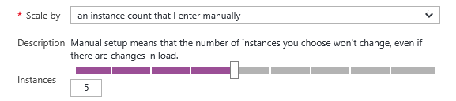
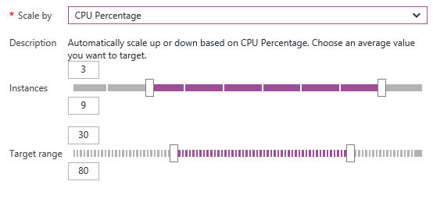
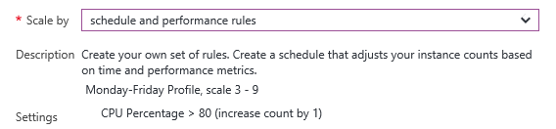
Manual Scaling vs. Auto-Scaling
Manual – Scale via portal or scripts
Auto – CPU Percentage
Auto – Schedule & Performance Rules
Notes:
Manual scaling can be as simple as moving a slider to increase the number of VM instances. Auto-scaling can be enacted by scaling the number of VM instances as CPU utilization increases, or through rules that you specify. An example of the latter is scaling up during certain hours of the day in which you anticipate peak demand.

Slide 15

Web App
Notes:
Demonstrate scaling out in this and the next two slides by showing the VM count increasing as traffic increases.

Slide 16
Web App

Slide 17
Web App

Slide 18
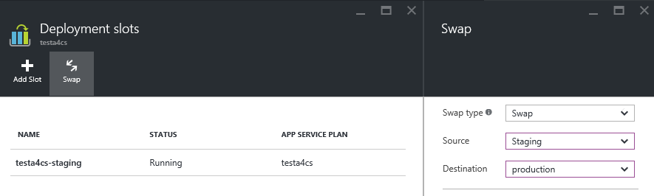
Deployment Slots
Use a Deploy-Confirm-Promote workflow
Promote via “swap” through Azure portal
http://sitename-slotname.azurewebsites.net
Notes:
When you deploy an Azure Web App, you can deploy to a separate deployment slot instead of the default production slot when running in the Standard or Premium App Service plan mode. Deployment slots are actually live web apps with their own hostnames. Web app content and configurations elements can be swapped between two deployment slots, including the production slot. Deploying your application to a deployment slot has the following benefits:
You can validate changes in a staging deployment slot before swapping it with the production slot.
Deploying a web app to a slot first and swapping it into production ensures that all instances of the slot are warmed up before being swapped into production. This eliminates downtime when you deploy your web app. The traffic redirection is seamless, and no requests are dropped as a result of swap operations. This entire workflow can be automated by configuring Auto Swap when pre-swap validation is not needed.
After a swap, the slot with the previously staged web app now has the previous production web app. If the changes swapped into the production slot are not as you expected, you can perform the same swap immediately to get your "last known good site" back
For more information, see https://azure.microsoft.com/en-us/documentation/articles/web-sites-staged-publishing/.

Slide 19
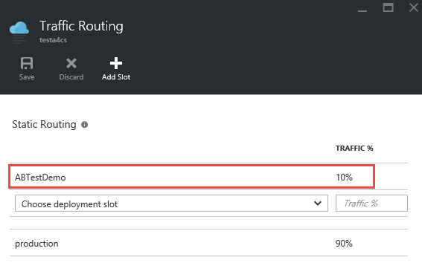
A/B Testing
Test changes by routing requests to different deployment slots
Use Traffic Routing to direct % of traffic to alternate slots
Notes:
A/B testing is useful for determining which of two landing pages, for example, is more effective in engaging customers. With Azure Web Apps, you can easily route traffic to different deployment slots by specifying percentage-based traffic allocations in the portal.

Slide 20






Continuous Integration
Web apps can be deployed manually via FTP or WebDeploy
Automate deployment using 3rd party source-control providers
Can also use a local Git repository from Azure Portal
Git
Visual Studio Team Services
CodePlex
GitHub
BitBucket
DropBox
Notes:
Continuous integration means deploying updates to your Web app as often as needed -- even several times a day. Azure supports many different deployment methods, including FTP, Git deployment (publishing from a local Git repository to Azure), and WebDeploy, which supports diff-deployment, database creation, and more. Visual Studio has integrated support for all three. Teams can also publish via third-party source-control providers such as Kudu (https://github.com/projectkudu/kudu/wiki/Deployment), which supports deployments from OneDrive and Dropbox, as well as repository-based deployments from GitHub, BitBucket, VSTS, and local Git repositories. For more information, see https://azure.microsoft.com/en-us/documentation/articles/web-sites-deploy/.

Slide 21


Continuous Integration + Deployment Slots
Production
5
Developer commits code
Automated process builds/compiles and deploys to staging slot
Automated and other tests validate content in staging slot
Staging content promoted to production
Users see updated site
1
4
2
3
Source Control
Staging
Test
Notes:
This process is a tried and tested one that is easily enacted using a combination of Azure features (e.g., deployment slots) and tooling support (e.g., Visual Studio).

Slide 22
App Service Plans
Billing and provisioning for App Service resources
 | Free | Shared | Basic | Standard | Premium
# of Apps | 10 | 100 | Unlimited | Unlimited | Unlimited
Shared Disk Space | 1 GB | 1 GB | 10 GB | 50 GB | 500 GB
Maximum Instances | 1 | 1 | 3 | 10 | 50
Autoscale | No | No | No | Yes | Yes
Staging Environments |  |  |  | 5 | 20
Custom Domains | No | Yes | Yes | Yes | Yes
SLA |  |  | 99.95%
Notes:
When you create an Azure Web App, you are asked to choose an App Service plan (or create a new one). These plans support 5 pricing tiers (Free, Shared, Basic, Standard, and Premium), with each tier offering a unique combination of capabilities and capacity. Apps in the same subscription and geographic location can share a plan. For more information, see https://azure.microsoft.com/en-us/documentation/articles/azure-web-sites-web-hosting-plans-in-depth-overview/.

Slide 23
Agenda
☒
Introduction to Cloud Computing and Microsoft Azure
Build with Azure App Services with GitHub
Experiment with Artificial Intelligence & Machine Learning
Connect with Microsoft during your student career
☒
◻
◻

Slide 24
AI
Notes:
It’s exciting. It gets a lot of hype going (which is honestly well-deserved). But it’s not very concrete.
What does AI mean? What does AI actually do?
Let me break it down for you a little bit.

Slide 25

Notes:
The term “Artificial Intelligence” was coined by John McCarthy, an American computer scientist, in 1956 at The Dartmouth Conference.
John McCarthy said that AI is “The science and engineering of making intelligent machines, especially intelligent computer programs”.
So, Artificial Intelligence is a field of computer science dedicated to simulating human intelligence.
The goal of AI is to create a machine that can mimic a human mind.
As of the last 15 years, the main exciting advancements we’re seeing in Artificial Intelligence are coming from a domain called Machine Learning.
So then, what’s machine learning?

Slide 26
…powered by
Machine Learning!
💻👩🏻‍🔬
”Machine learning is the science of getting computers to act without being explicitly programmed, but instead letting them learn a few tricks on their own.”
-- Dr. Danko NIkolic
Notes:
Machine learning is a subfield of Artificial Intelligence.
Technically, machine learning is a method of data analysis that automates analytical model building.
But we can think of it as a technique to train artificially intelligent systems without needing to be specifically programmed.
Instead, you create an algorithm that takes in data and uses statistics to predict an output that’s reasonably correct.
If you’ve bought something on the internet and seen “related products” for you to buy, those suggested products were almost certainly selected using a machine learning algorithm.
Or if you’re on Netflix, and you’ve been watching some shows, and it suggests other shows to check out – they picked those shows using a machine learning algorithm.
Terms are often used interchangeably.
One funny, and true way of remembering the difference, is that when you’re trying to sell a product, you call it AI. When you’re trying to hire someone to build the product, you call it Machine Learning.

Slide 27
Demystifying machine learning
Age | Income | Education | Gender | Housing
61 | $65,000 | Moderate | F | Own
42 | $72,000 | High | F | Rent
18 | $25,000 | Moderate | M | Other
22 | $36,000 | Low | M | Rent
Training data
31 | $52,000 | High | M | ?
What we know
“features”, “attributes”
Thing to predict
“class”, “label”
Notes:
Okay, quick, simple example.
So, like I said, machine learning works through algorithms that take in data and use statistics to predict a reasonably correct output.
As an example, imagine you’re trying to predict whether someone rents or owns their home.
To do this, we’d need a bunch of data about all kinds of people who both rent and own homes.
In this example, we have their age, their income, their education level, gender, and of course, whether they own or rent.
… remember it in a “model”
Then, we use that model – put in all of the features of the person we’re trying to guess about – and the model will give us its best prediction of whether or not that person owns or rents their home.

Slide 28


How to create a predictive ML model
Build
Choose & configure your model
Clean
data
Filter
data
Train
Use your training dataset to build the model
Test
Use your test dataset to validate the model
Predict
If the model is good enough, use it!
Notes:
ML starts with data which can come from a variety of sources. You might pull-in a large static dataset like historical weather temperatures or on-time flight arrivals in order predict a likely outcome like global climate change or whether your flight from Chicago will arrive on time. There are also tools to capture and stream real-time data. Say you’re in a car race and telemetry is coming-in a 1GB per second. If you could build a model that could predict when a pitstop is most needed based on “features” like tire pressure, fuel, and engine temp, would that be the difference between winning or not (or at least NOT crashing the car)? ☺
Most data typically needs to be "cleaned" before it is used. Examples of cleaning include removing rows with missing data, replacing missing data algorithmically, removing duplicate rows, and removing rows containing "outliers." Data scientists will also perform “feature selection” or more advanced, math-intensive “feature engineering”– in which you’re optimizing your dataset to maximize its training potential. In practice, all of this can be very time-intensive and often consumes 50%-80% of the time required to build the model.
Once the data is ready, you select an algorithm and "train" the model by allowing it to iterate over the data and find patterns in it. After that comes scoring and evaluating the model, which tells you how well the model is able to predict outcomes. Machine Learning is a trial and error process but fortunately there are some amazing open source tools & libraries to help you do so. You might have heard of the term “deep learning” – this often refers to specific algorithms that can be used with popular frameworks like Keras, Tensorflow, and CNTK. To build the ground-breaking predictive models with huge datasets, that’s also where the compute potential and flexibility of a cloud platform like Azure comes in.

Slide 29
Demo Machine Learning Studio
Notes:
//OPTIONAL DEMO | Azure Machine Learning Studio
//this is a brief demo just to reinforce the key concepts of machine learning in a pre-coding, approachable way. See next slide for talk track.
//extra credit and extra time, show the same scenario in Machine Learning Workbench using Python

Slide 30
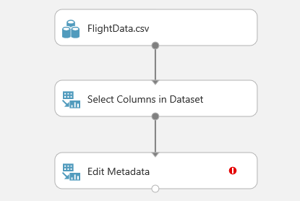
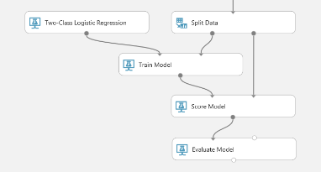
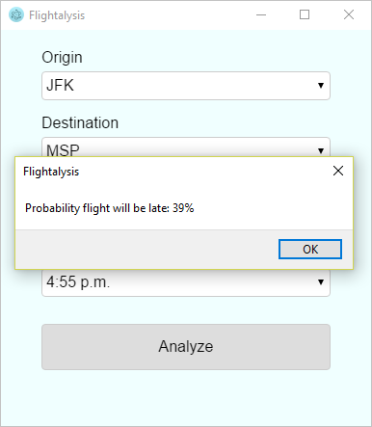
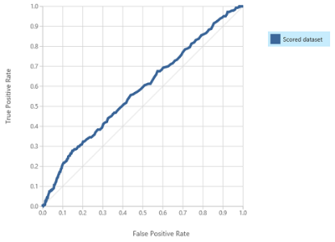
Predicting on-time flight arrivals with ML Studio
1 | Select dataset
2 | Build model
4 | Deploy!
3 | Evaluate
Notes:
//demo is currently at: https://github.com/Microsoft/computerscience/tree/master/Events/Event-In-Box/Machine%20Learning%20Challenge
//we suggest you pull this into your own Azure ML Studio to show the model running. Set-up takes about 20 mins prior to this presentation.
Azure Machine Learning Studio is a cloud-based predictive-analytics service that offers a streamlined experience for data scientists of all skill levels. It features an easy to use, drag-and-drop interface for building machine-learning models. It comes with a library of time-saving experiments and features best-in-class algorithms developed and tested in the real world by Microsoft businesses such as Bing. And its built-in support for R and Python means you can build custom scripts to customize your model. Once you've built and trained your model, you can easily expose it as a Web service that is consumable from a variety of programming languages.
//Step through the building of a flight-tracking model here: https://github.com/Microsoft/computerscience/blob/master/Events/Event-In-Box/Machine%20Learning%20Challenge/Machine%20Learning%20Challenge.md

Slide 31
Agenda
☑
Demystifying AI and Machine Learning
Why AI will change the world
How to get started and win a hack with AI
Ways to connect with Microsoft during your student career
◻
◻
◻

Slide 32
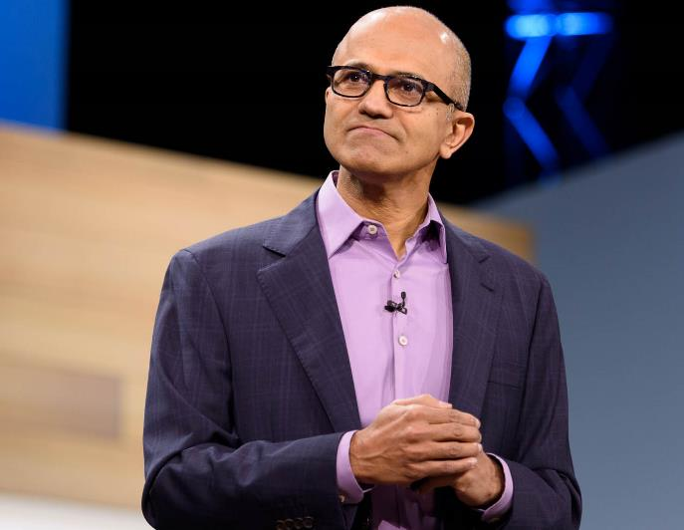
Microsoft’s aim:
Making AI available to everyone
We are pursuing AI to empower every person and every institution ... so that they can go on to solve the most pressing problems of our society and our economy.
– Satya Nadella, CEO, Microsoft
Notes:
My take on this (and Microsoft’s take as well ☺) is that we should be using AI to enable and empower everyone.
I think of Microsoft as doing this in three main ways:
Creating products that use AI in innovative ways enable all users
Building tools that developers such as yourselves can use to create (I’ll be showing you how to use some of these tools later)
Actively contributing to the global dialogue of ethical implications of AI. We believe AI should augment human capability – help us eliminate mundane and repetitive tasks and instead be more productive and creative. Harnessing its potential also requires us to adopt an open & questioning mindset. We have a shared responsibility to ensure that that the models that we build (and the AI experiences that consume them) are fair, reliable and safe, private and secure, inclusive, transparent, and accountable. We’re working with technology communities, governments, universities, and organizations on this.
//this is super popular right now so spend as much time on it as you feel qualified to say. We’re getting a lot of input from hack organizers and students that they want a tech platform provider like Microsoft to speak-up on ethics. You can skim the first 20-page Foreword or read the entire 130 page e-book on Microsoft’s positions here: https://news.microsoft.com/futurecomputed/ .
//optionally bridge to Microsoft Mission slide, see appendix if you want to pull it in

Slide 33

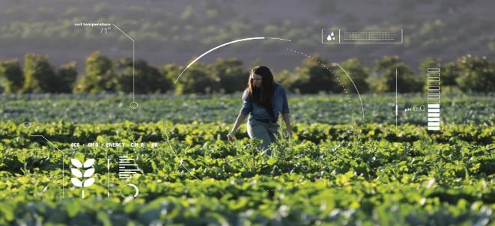


Microsoft AI for Good
Notes:
//to prep for talk track on this slide, see https://www.microsoft.com/en-us/ai/ai-for-good. Videos are particularly good. This is about rich storytelling and personal connection to technology and using concrete examples of why AI will change the World. Speaker can fill 20 seconds or 5 minutes according to preference. The grants are important to academic audiences because many of them (in grad school) may apply or join open source projects for the same.
AI for Good is Microsoft’s commitment to providing technology, resource, and expertise to empower those working to solve humanitarian issues and create a more sustainable and accessible world.
$115M in grants over next few years:
AI for Earth $50M
AI for Accessibility $25M
AI for Humanitarian $40M
//talk about your favorite examples and what they mean to you personally and professionally
AI for Humanitarian Action will harness the power of AI to focus on four priorities – helping the world recover from disasters, addressing the needs of children, protecting refugees and displaced people, and promoting respect for human rights.
Project Premonition
AI technology and cloud software enables Project Premonition researchers to detect and track pathogens to prevent outbreaks and protect biodiversity.
Operation Smile gives hope to more children
Nonprofit partner Operation Smile uses a facial modeling algorithm and Microsoft Pix to improve their surgical outcomes and help more children in need of facial surgeries.
The Yield
How do we feed the world without wrecking the planet? The Yield uses Microsoft AI to help farmers create localized predictions, so they know exactly when to plant, when to water, and when to harvest to create more food and less waste.
Iconem
Historical sites are disappearing every day. The team at Iconem uses Microsoft AI to help preserve ancient architectural sites for future generations.

Slide 34

Wild Me + Microsoft
Notes:
One example, Microsoft also works with a company called Wild Me on a project called WildBook.
Wildbook is an open source framework for wildlife data management: http://www.wildbook.org
Basically, Wildbook wants to identify and track specific individual animals from endangered species.
WildBook uses Azure’s cognitive services to identify individual animals in

Slide 35
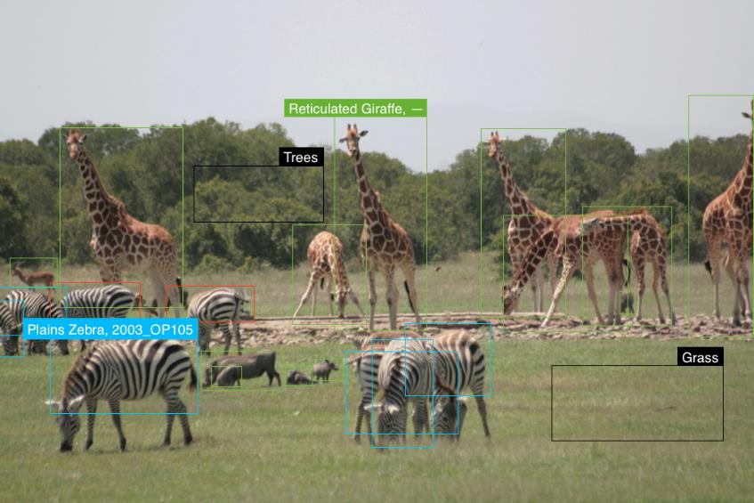
Image Analysis: Detection
Notes:
Willdbook can use azure’s cognitive services to detect and identify not only animals based on their species… but…

Slide 36

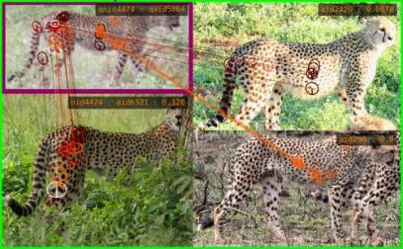
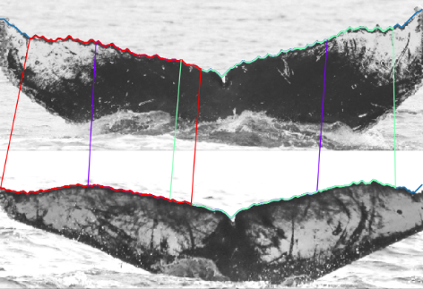
Image Analysis: Identification
Notes:
It actually uses custom vision services + custom models to ID specific animals based on various traits.
For example, zebras have specific stripe patterns, and elephants have wrinkles. Whales have unique ridges on their tails.
So every type of animal needs a specifically trained model which are used to use mark & recapture.
No OOTB content management system (CMS)
Build it: Wildbook- open source framework for wildlife data management: http://www.wildbook.org
rapidly share research techniques, tools, and investment across groups and species (even if not directly collaborating)
filter, search, export data
engage citizen scientists!
47,000+ sighting records
9100+ whale sharks
5900+ individual data contributors
40 organizations participating
75+% of submitted data leads to identifications
Long list of publications
Critical data contributor for Red List revision to Endangered
We foresee a world where:
Intelligent agents collect and curate “Big Data” for wildlife using largely unsupervised A.I.
Data sources are heterogeneous but blended
Population estimates for species are continuous
Wildlife researchers focus on analysis not curation
Conservation action is continuously refined

Slide 37
Demos Azure Cognitive Services
Notes:
//this is a series of demos to reinforce the possibilities with AI for Good and to showcase the most popular service used at student hacks (Computer Vision, )
//see next slide for talk track and screenshots in case demo fails or internet connectivity is bad

Slide 38

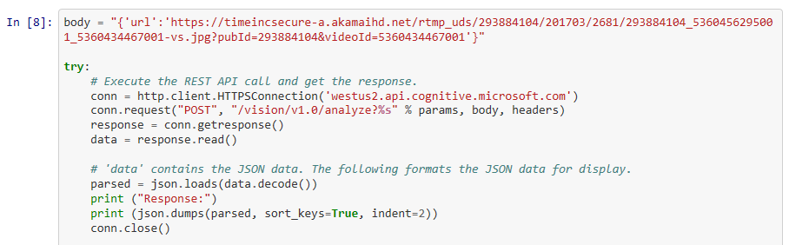
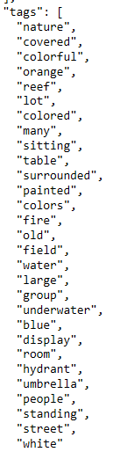
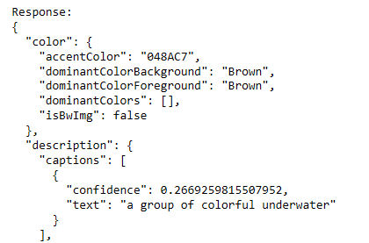
Detecting Coral Reefs with Scuba Diving Imagery
<input>
<call Cog Services>
<output.JSON>
Notes:
//demo is currently at: https://github.com/shanamatthews/hackathons/blob/master/hackmit/cogservices_demos/cogservices_vision.ipynb
//we suggest you pull this into your own Azure Notebook and run it yourself to show how the output is generated but you can fall-back to using the pre-generated output in the URL above
Here is an example of how you might create something similar for your hack: We’ve uploaded a series of pictures with corals, scuba diving equipment, and other reef-related images located in user-defined geospatial locations. We will also explore a potential edge case with skydiving, as colors and gear visually might be similar to scuba diving.
Our first image is very obviously a photo of a coral reef with wildlife and fish; the keyword reef is included in the JSON response that we obtain from Cognitive Services. To extract similar images from your corpus of files, you would first filter by geospatial location and then search for reef in Cognitive Services JSON responses.
//show example 1 and describe the JSON output
The second image is not as straightforward to parse; however, you would be able to deduce that this is a scuba diving photo by searching through geospatially-filtered JSON responses for water sport and underwater, as well as potentially man or woman and swimming.
//show example 2 and describe the JSON output
Similar to the image above; but ocean floor, underwater, and swimming.
//show example 3 and describe the JSON output
Our final test image would be a potential edge case, as skydiving and scuba diving are very visually similar. However, you can see that Cognitive Services detects this is an aerial photo with high confidence. This would not be filtered as a potential scuba photo.
//show skydiving and explain why cognitive was able to identify this as a different image from similar underwater images.
Now let’s say your solution needed a *higher* level of detail than what Cognitive Services was providing. For example, identifying specific markings of animals similar to Wild Me. At some point, your demands exceeds that capability of the “stock” Computer Vision. So that’s where customizing your own model comes-in. Fortunately we have Custom Vision Services where you can build on our own pre-built AI without having to build and train your own machine learning model.
//bridge to Microsoft Learn

Slide 39
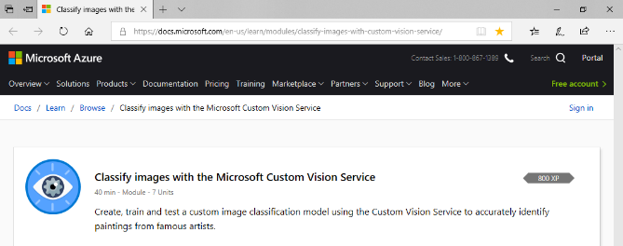
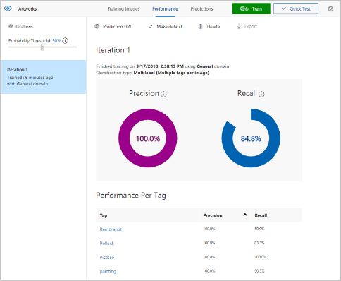
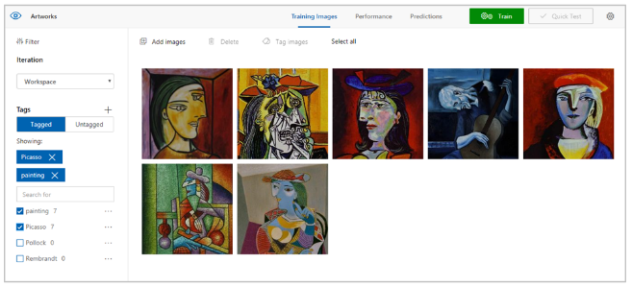
Classify images with Custom Vision
docs.microsoft.com/learn/
Notes:
//this is less about demo’ing Custom Vision which has a pretty straightforward UX and more about teaching lifetime learning. Introduce our new platform Microsoft Learn here.
//Microsoft Learn lab: https://docs.microsoft.com/en-us/learn/modules/classify-images-with-custom-vision-service/2-upload-tagged-images
Developers are lifetime learners, constantly using the latest libraries and services from a growing number of open source libraries and tech platforms. It can be difficult to keep up with it all. At Microsoft, we’ve made huge improvements in our developer documentation to help you quickly use the latest.
Our new platform is Microsoft Learn. Let’s say you’re here at the hack and you want to know how to use Custom Vision Services asap. We have a lab for that that gets straight to the point so you don’t have to spend hours combing through formal training. Best of all, many of these labs have their own sandbox environment hosted in Azure so they require a subscription. You spin-up the lab VM and tear it down in minutes.
The example of this slide are of various Picasso’s. This is a very similar scenario to underwater species identification – both require an added features and training that are specific to the domain. You can see I can upload additional photos to further improve my model and view the results. Then I can publish that model to use it in my new solution.

Slide 40






Azure Cognitive Services are ready to go pre-trained AI models
Vision
From faces to feelings, allow your apps to understand images and videos
Speech
Hear and speak to your users by filtering noise, identifying speakers, and understanding intent
Language
Process text and learn how to recognize what users want
Knowledge
Tap into rich knowledge amassed from the web, academia, or your own data
Search
Access billions of webpages, images, videos, and news articles with the power of Bing APIs
Notes:
/*Speakers: you can skip this slide if you prefer to demo a series of more code-first Cognitive Services demos. Here are the ones we recommend:
Shana Matthews keeps a list of notebook-based demos here: https://github.com/shanamatthews/hackathons/tree/master/hackmit/cogservices_demos
Use the web-based demos in-browser:
Computer Vision: https://azure.microsoft.com/en-us/services/cognitive-services/computer-vision/#analyze
Custom Text-to-speech: https://azure.microsoft.com/en-us/services/cognitive-services/speech-to-text/#custom-speech
Text Analytics: https://azure.microsoft.com/en-us/services/cognitive-services/text-analytics/
Video Indexer (way cool): https://vi.microsoft.com/
Build on of the following labs and then demo them (these take more time to prep but they are more complete solutions):
Build a web app with Text Analytics: https://github.com/Microsoft/computerscience/blob/master/Labs/Web%20Development/Azure%20Web%20Apps%20and%20GitHub/Deploying%20a%20Cognitive%20Services%20Web%20Site%20to%20Azure%20via%20GitHub.md
Build Customer Vision model: https://github.com/Microsoft/computerscience/blob/master/Labs/AI%20and%20Machine%20Learning/Custom%20Vision%20Service/Custom%20Vision%20Service.md
Build a custom language model: https://github.com/Microsoft/computerscience/blob/master/Labs/AI%20and%20Machine%20Learning/LUIS/LUIS.md
*/
//Here’s the talk track to frame
We find that many teams at hacks want to start with pre-built AI given the limited time. You can always customize it later.
Cognitive Services is actually an entire suite of intelligent APIs, so you can analyze video, images, voice, language, gestures and more.
It takes just a few lines of code to enable each API in your app and since you are just calling an API you can call it from the programming language of your choice.
These services are built and supported by Microsoft. Many of them are used in our own products.
[Briefly describe the five categories on the slide, then pick a favorite example to describe in more detail. Below is a list of some Cognitive Services you could describe, pick one or two.]
Vision: Image-processing algorithms to smartly identify, caption, and moderate your pictures
Computer Vision: Distill actionable information from images
Content Moderator: Automatically moderate potentially offensive images, text, and videos
Customer Vision Service: Train a web service to recognize specific content in images
Face: Identify human faces and emotions in images
Video Indexer: Easily extract insights from your videos to enrich your applications
Speech: Convert spoken audio into text, use voice for verification, or add speaker recognition to your app
Bing Speech: Convert speech to text and text to speech
Speaker Recognition: Use speech to identify and authenticate individual speakers
Custom Speech Service: Overcome speech-recognition barriers like speaking style, background noise, and vocabulary
Translator Speech: Easily conduct real-time speech translation on your app
Language: Enable your apps to process natural language with pre-built scripts, evaluate sentiment, and learn how to recognize what users want
Bing Spell Check: Add spell checking functionality to your app
Language Understanding Intelligent Service (LUIS): Add language understanding intelligence to your apps with minimal effort
Linguistic Analysis: Easily parse complex text with language analysis
Text Analytics: Easily evaluate sentiment, language, and key phrases to understand what users want
Translator Text: Easily conduct machine translation for 60+ languages
Knowledge: Map complex information and data in order to solve tasks such as intelligent recommendations and semantic search
Knowledge Exploration Service: Enable interactive search experiences over structured data via natural language inputs
Entity Linking Service: Power your app's data links with named entity recognition and disambiguation
Academic Knowledge: Tap into the wealth of academic content in the Microsoft Academic Graph using the Academic Knowledge API
QnA Maker: Distill information into an easy-to-navigate frequently-asked-questions (FAQ) document for bot services
Customer Decision Service: Create custom experiences with adaptive, contextual decision-making
Search: Add Bing Search APIs to your apps and harness the ability to comb billions of webpages, images, videos, and news articles with a single API call
Bing Autosuggest: Give your app intelligent autosuggest options for searches
Bing News Search: Search for news and get comprehensive results
Bing Web Search: Get enhanced search details from billions of web documents
Bing Entity Search: Enrich your experiences by identifying and augmenting entity information from the web
Bing Image Search: Search for images and get comprehensive results
Bing Video Search: Search for videos and get comprehensive results
Bing Custom Search: Create tailored site search or vertical search experiences for topics you care about
Labs: Cognitive Services Labs are early-preview limited-availability leading innovation APIs and SDKs that allow developers to start experimenting with Microsoft’s latest and greatest Cognitive Services
Project Prague: SDK to incorporate gesture-based controls into your apps. Quickly define and implement customized hand gestures, creating a more natural user experience; limited private preview availability at launch
Project Cuzco: API to help developers find events associated with Wikipedia entities; begin with a Wikipedia entity and receive a list of related events organized by time
Project Johannesburg: API to calculate route logistics for deeper location intelligence to account for specific enterprise requirements; for example, weight, height, length, hazardous materials, and so on
Project Nanjing: API to calculate isochrones—time and distance-based recommendations for enterprise route optimization
Project Abu Dhabi: API to create distance matrices, enabling you to calculate a histogram of travel times and serve as a stepping stone for enterprise route optimization
Project Local Insights: API to help “score” the attractiveness of a location, based on how many of a particular amenity are within a specific distance; for example, restaurants, parks, and transit stops

Slide 41
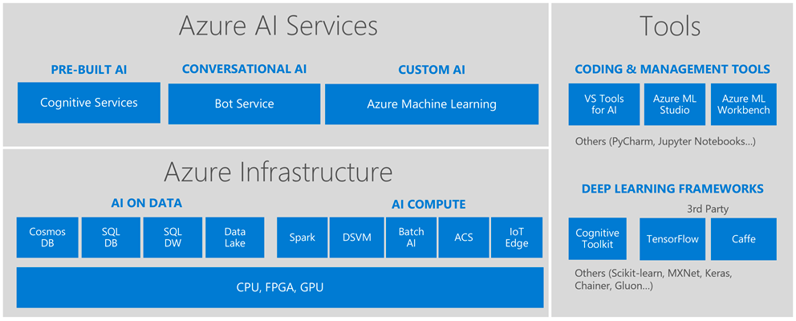
Microsoft AI Platform
Notes:
So we’ve learned about pre-built AI but what happens when you’ve gotten to the point where you want to build your own models? Turns out that Microsoft has already many of those “building blocks” too because that’s how we build intelligence into our own products like Cortana, Office, Windows, and XBOX.
//you’re recapping this first part to reinforce the highest pri concepts. This is the most important part for student devs.
And you don’t have to be an expert coder to start building with it:
AI services: Use these high-level “finished” services to add intelligence to your apps. In addition to computer vision, speech, and language, we also have our own Bot Service.
AI tools: If you want to start exploring training your own machine learning models but don’t have a lot of coding experience, you’re already learned about Azure Machine Learning Studio, the drag and drop tool for training and deploying predictive models. Btw it also support custom Python and R coding modules.
But maybe you have already started learning python Pandas and tools like Sci kit learn to train your own models.
AI infrastructure:
Tools like Azure Data Lake allow you to access data from multiple data sources to train your models. You might already be familiar with the basics for databases through SQL Server or Blob storage.
The Data Science Virtual Machine saves you time with pre-installed tools (more on that later)
AI tools:
Azure ML Workbench allows you to write your own Python code to train models
Azure notebooks is the Azure implementation of Jupyter notebooks
Or maybe you’re ready to build your own models and algorithms on “bare metal” infrastructure
AI infrastructure:
Open source tools like Apache spark are supported on Azure
Batch AI allows you to train models on clusters of virtual machines
Azure Container Service can help you manage your Kubernetes environment
AI tools:
Azure supports open source frameworks like Tensorflow and Caffe where you can use neutral networks to train your models
Keras in another good solution for rapid prototyping
Cognitive Toolkit is Microsoft’s own framework for deep learning which is design for the largest datasets with performance in mind
//optional: share your personal favorite or recent project you’re working on

Slide 42
I’m at a hack. What should I use?
Microsoft AI Platform
Build your own or consume pre-trained models?
Build your own model
Use pre-built models
Azure Machine Learning
Cognitive Services, Bot Services
Customize?
Which experience do you want?
Code-first
Visual-tooling
Tools & Services
Machine Learning
Workbench + Services
Machine Learning Studio
What engine(s) do you want to use?
SQL Server
Spark
Hadoop
Azure Batch
DSVM
Azure Container Service
Notes:
But we’re a hack and that means you have limited time. Here’s a handy flowchart for picking the right AI tool for your goals.
It ultimately comes down to two choices:
Do you want to build your own model?
How much code do you want to write?
If you’re focused on creating the absolute best model, you might want to prioritize your hack-time on that. In you’re more interested in the User Experience – say building a mobile or web app that showcases what how your AI will be expressed, then maybe pre-built AI on the back-end is sufficient. Maybe your team has talents in both areas. Either way, our Microsoft mentors here can also help get your pointed in the right direction.
//pause to make sure audience has enough time to scan the slide.

Slide 43
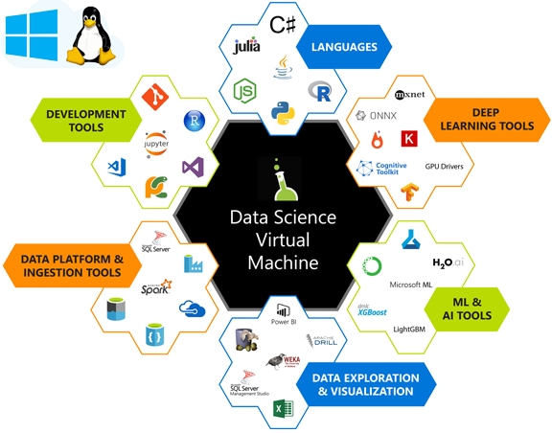
Data Science Virtual Machine. Ultimate choice.
40%
of Azure VMs run Linux
Notes:
If you want to build your own models on a VM, you have an ultimate companion in the Data Science Virtual Machine:
It provides all the big data, data analytics, and machine learning tools you need in one pre-configured, ready-to-use environment, which you can automatically spin up in Azure in one of 2 Linux versions or in a Windows version if you prefer.
You can choose many different sizes and configurations – some have GPUs or CPU/RAM configuration that are optimized for specific types of Deep Learning tasks like Image Recognition.
And Visual Studio and the Azure SDK comes pre-installed along with language packs so you can use what you know – R, Python, SQL, and C#.
//ad-lib on some of the ways you personally use the DSVM or favorite scenarios
[Complete list of what’s on the DSVM below:]
Azure Machine Learning Workbench
Microsoft ML Server Developer Edition
Anaconda Python distribution
Microsoft R Server 9.2.1 with Microsoft R Open 3.4.1, MicrosoftML package with machine learning algorithms, RevoScaleR and revoscalepy for distributed and remote computing, and R and Python Operationalization
Jupyter Notebook (with R, Python, PySpark kernels)
Visual Studio Code, IntelliJ IDEA, PyCharm, and Atom
Power BI desktop
SQL Server 2017 Developer Edition
Single node local Hadoop
Standalone Spark instance for local development and testing
Azure command-line interface
H2O, Deep Water, and Sparkling Water
JuliaPro
Intel Math Kernel Library
xgboost for gradient boosting
Machine learning and Data Analytics tools
Deep Learning Frameworks: A rich set of AI frameworks including Microsoft Cognitive Toolkit, TensorFlow, Chainer, Apache MXNet, Keras are included on the VM.
Vowpal Wabbit: A fast machine learning system supporting techniques such as online, hashing, Allreduce, reductions, learning2search, active, and interactive learning.
XGBoost: A tool providing fast and accurate boosted tree implementation.
Rattle (the R Analytical Tool To Learn Easily): A tool that makes getting started with data analytics and machine learning in R easy, with GUI-based data exploration, and modeling with automatic R code generation.
Weka : A visual data mining and machine learning software in Java.
Apache Drill: A schema-free SQL Query Engine for Hadoop, NoSQL and Cloud Storage. Supports ODBC and JDBC interfaces to enable querying NoSQL and files from standard BI tools like Power BI, Excel, Tableau.
Libraries in R and Python for use in Azure Machine Learning and other Azure services
Git including Git Bash to work with source code repositories including GitHub, Visual Studio Team Services
Windows ports of several popular Linux command-line utilities (including awk, sed, perl, grep, find, wget, curl etc) accessible through command prompt.
Data Science Virtual Machine page.
Other Versions of the Data Science Virtual Machine
An Ubuntu image is available as well, with many similar tools plus a few additional deep learning frameworks. A CentOS image is also available. We also offer a Windows Server 2012 edition of the data science virtual machine though a few tools are only available on the Windows Server 2016 edition. Otherwise, this article also applies to the Windows Server 2012 edition.
⁴ ZDNet. “Microsoft says 40 percent of all VMs now are running Linux.” October 2017. www.zdnet.com/article/microsoft-says-40-percent-of-all-vms-in-azure-now-are-running-linux/.

Slide 44
Linux
Python
Java
node.js
Docker
Android
And many more …
With Azure, you have choices
40%
of Azure VMs run Linux⁴
Notes:
When you’re looking at cloud platforms, the first thing you want to make sure about—understandably—is whether you can build with your preferred tools and languages on your device. In other words, it needs to be an open platform.
So let’s make sure one thing is clear: Azure is open. You can run any stack, whether it’s Linux operating system (OS)–based or Windows OS–based. In fact, about one-third of Azure virtual machines (VMs) specifically run Linux. You can also use open-source tools like a Kubernetes cluster in Azure Container Service. And Azure supports Docker too, of course. And GitHub platform–based DevOps. And more.
[Ad-lib on your favorite technologies. Provide examples of the great variety of workloads that can run in Azure, landing the point that Azure is not even remotely limited to the Microsoft stack:
Web app in Java
Android app using Azure App Service
Xamarin app with C# targeting 3+ platforms
Data science Linux VM
Apps with TensorFlow and similar
The point is, you have choices. Choices that help you maximize your existing investments. Get support for infrastructure as a service (IaaS) on Linux, Java, and PHP or node.js application platforms. Develop and test your Linux and open-source components in Azure. You bring the tools you love and skills you already have, and you run virtually any application using your data source, with your operating system, on your device.
Provide cross-device experiences with support for all major mobile platforms.]
⁴ ZDNet. “Microsoft says 40 percent of all VMs now are running Linux.” October 2017. www.zdnet.com/article/microsoft-says-40-percent-of-all-vms-in-azure-now-are-running-linux/.

Slide 45
Demos VMs | Notebooks | Keras w Tensorflow
Notes:
//Speakers: With limited time, make sure to spend at least 3 minutes on navigating Azure (demo 1). Keras is optional but *very* popular for rapid prototyping amongst most sophisticated teams. We’ve included screenshots of the demos on the slides below in case your internet connection or demo fails. The talk tracks for these demos are contained in the labs or slides too. Please note that you’ll need to set-up and prep for these on your local machine, in your Azure account, or within a VM. Be sure to test your internet connection and refresh the cloud-based pages / remote connection prior to the demos.
Demo 1 | How to navigate Azure and set-up your first VM
http://portal.azure.com. Make sure you cover the search box, left-nav, and Azure Cloud CLI. Set-up a Data Science VM, describe Resource Groups and VM Sizes. Also show them the Auto shut-off feature. See next slide for full talk track.
If you want to demo how easy it is to create a VM in the CLI, code is here:
https://docs.microsoft.com/en-us/azure/virtual-machines/linux/quick-create-cli
Demo 2 | Keras w Tensorflow in an Azure Notebook
https://github.com/Microsoft/computerscience/blob/master/Labs/AI%20and%20Machine%20Learning/Keras/Keras.md
This labs takes about 20 mins to set-up and learn. Describe how students can build a model that predicts IMDB movie review sentiment. Azure Notebooks is an implementation of Jupyter Notebooks with common libraries like python scikit-learn, keras, tensorflow already built-in. This means you can start rapidly prototyping by writing some python immediately.

Slide 46
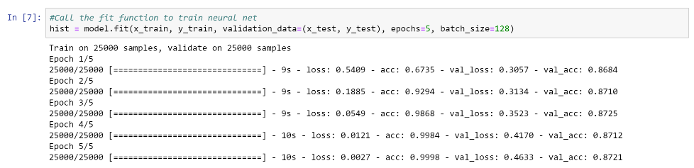
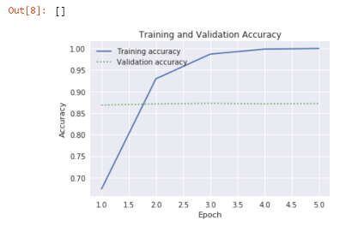
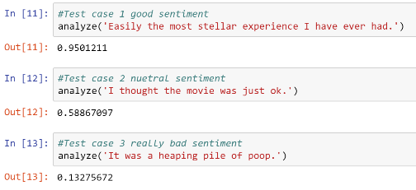
Predict the sentiment of IMDB movie review
Rapidly prototype your model using Keras and Tensorflow on an Azure Notebook
40%
of Azure VMs run Linux
Notes:
//
https://github.com/Microsoft/computerscience/blob/master/Labs/AI%20and%20Machine%20Learning/Keras/Keras.md
This labs takes about 20 mins to set-up and learn. Describe how students can build a model that predicts IMDB movie review sentiment. Azure Notebooks is an implementation of Jupyter Notebooks with common libraries like python scikit-learn, keras, tensorflow already built-in. This means you can start rapidly prototyping by writing some python immediately.
The lab itself has a good talk track but be sure to cover key concepts like:
How data was transformed so that it can easily be trained
What a training epoch is and Loss/Accuracy is
The graph showing how the first 3 epochs achieve most of the accuracy and with diminishing returns after. This is a small data set but what if the power of the cloud compute could achieve 0.1 or 0.01 better prediction. Maybe that wouldn’t matter for movie sentiment. But what about predicting malignant cancerous tumors?
Evaluate the sentiment values (good, neutral, negative) and their corresponding predictive scores

Slide 47
Agenda
☒
Introduction to Cloud Computing and Microsoft Azure
Build with Azure App Services with GitHub
Experiment with Artificial Intelligence & Machine Learning
Connect with Microsoft during your student career
☒
☒
◻

Slide 48
Agenda
☑
Demystifying AI and Machine Learning
Why AI will change the world
How to get started and win a hack with AI
Ways to connect with Microsoft during your student career
☑
☑
◻

Slide 49

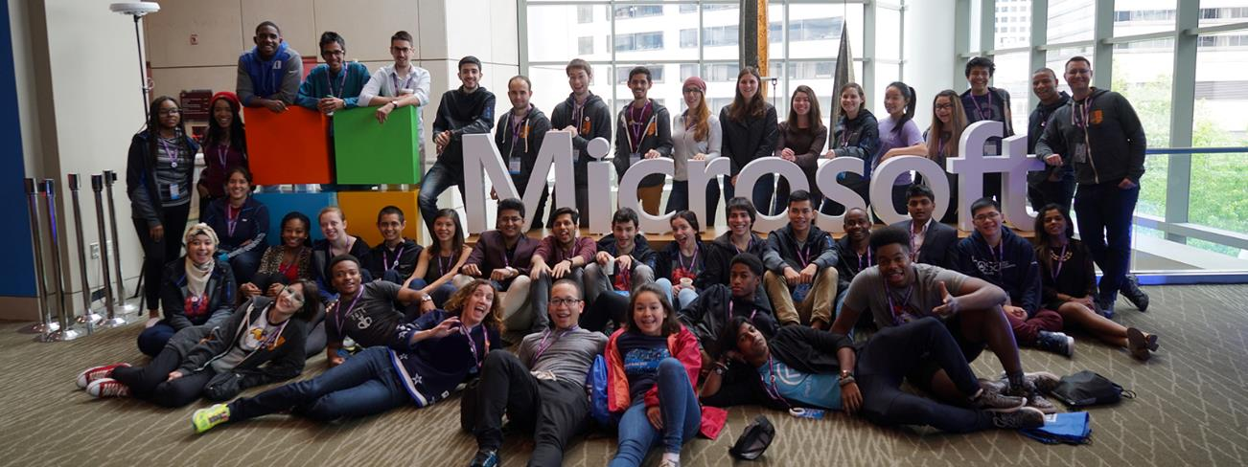
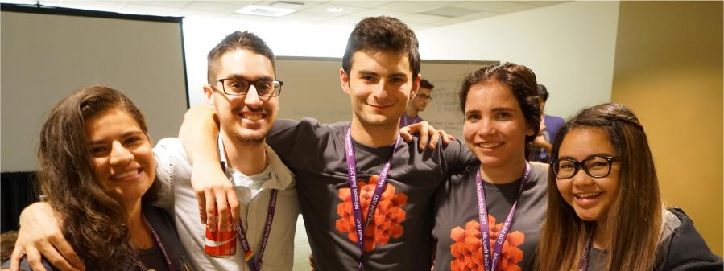
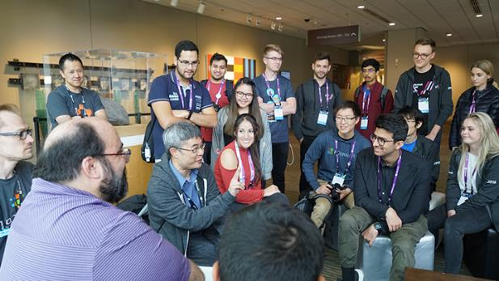
Microsoft Student Partners are on-campus student leaders with a passion for sharing technology with their classmates.
studentpartners.microsoft.com
40%
of Azure VMs run Linux
Notes:
If you find yourself wanting an opportunity to lead and share you passion for technology, then potentially the Microsoft Student Partner program is for you. We are a community of university students around the world with an interest in technology. Coding is our shared common language. You might find yourself leading your own hackathon, mentoring computer science students, or unlocking the next great idea with your team – it’s all up to you. The program is all about gaining leadership experiences and getting access to resources and develop your technical and career skills. And we have a lot of fun too.

Slide 50

Team up. Use your creativity, your passion, and your knowledge of technology to create applications that shape how we live, work, and play.
Microsoft's premier student technology competition
imagine.microsoft.com/usa
Notes:
If you really like today’s challenges, we encourage you to consider taking the next step with Imagine Cup.
Imagine Cup is a global competition for the next generation of students. Team up, and use your creativity, passion, and knowledge of technology to create applications that shape how we live, work, and play. Every year, tens of thousands of students from across the globe compete for cash, travel, and prizes and for the honor of taking home the Imagine Cup!
We are soon going to announce details for this year’s Imagine Cup. Register online at https://imagine.microsoft.com/usa

Slide 51

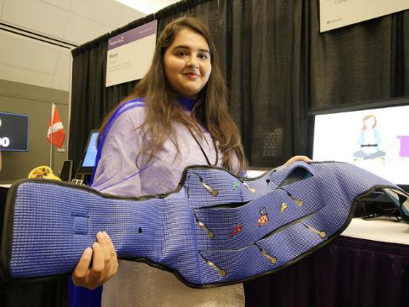
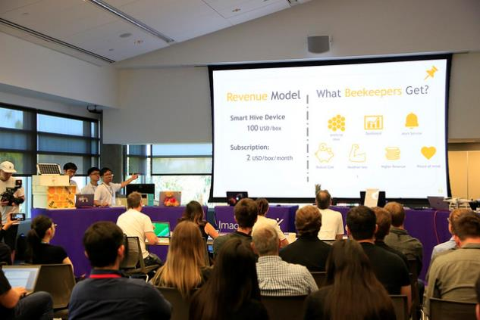
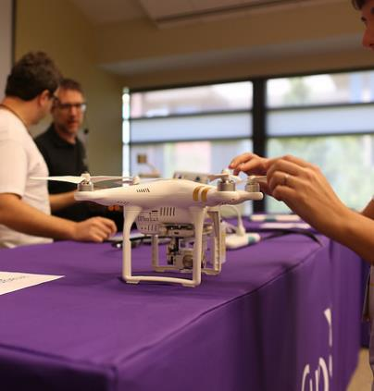
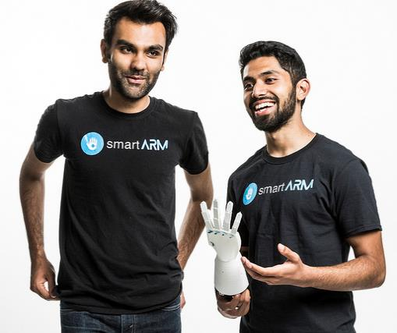
Notes:
//optional extended version of Imagine Cup to tie back to the “AI changing world theme”
And these students too are changing the world with AI
smartARM of Canada created an AI-powered robotic prothetic arm and become the 2018 World Champion. Their project started at a hackathon just like this one.
BeeConnex of Thailand built AI powered IoT smart monitor for beehives
All female team, Fe Amaan of Pakistan created an IoT low-cost pregnancy monitor can predict complications and send those instructions to doctors
The Nash team in Argentina built a series of autonomous drones to scan for survivors in the event of natural disaster
And SochWare of Nepal put a cheap smartphone in the hands of rural farmers that uses AI to detect plant diseases and save crops.
What all these projects had in common was that a student team had a passion for solving a problem where AI might complement human productivity and creativity.

Slide 52



Azure for Students
+
Verify as a student
$100 annual credit
25+ free products
Pay nothing
No credit card required
Ability to convert to pay-as-you-go
for 12 months or until $100 credit is used
aka.ms/azure4students
Notes:
So how are you going to use all these AI and ML services at today’s hack?
Now you can get $100 of credit plus a free-tier of Azure products to use in today’s challenges, your own apps, in your university courses, and potentially in Imagine Cup, too. The free tier includes AI capabilities like Computer Vision and Azure Machine Learning, in addition to VMs to build your own solutions.
Here’s the short-link for this offer; we’ll also post this link as you begin your challenges.
[See range of free-tier services and details at http://aka.ms/azure4students.]

Slide 53
Agenda
☒
Introduction to Cloud Computing and Microsoft Azure
Build with Azure App Services with GitHub
Experiment with Artificial Intelligence & Machine Learning
Connect with Microsoft during your student career
☒
☒
☒

Slide 54

Microsoft mission
Empower every person and every organization on the planet to achieve more

Slide 55
Thank you!

Slide 56
docs.microsoft.com/azure

Slide 57
Demo Microsoft Translator
Notes:
//OPTIONAL DEMO | Microsoft Translator
//if you cut a demo for time, this is it because it’s a well-known scenario and less approachable to students. However, it does showcase the full capability of AI in a “UN-style everyone hears their native tongue simultaneously” kinda awesome factor. Google does this too. The important part is to talk about it as an engineering problem – what level of sophistication is required to achieve the billions of people and millions of dialects on our planet? How is this a problem AI can uniquely solve? How do we avoid bias / be inclusive as possible?
//optional talk about or demo PowerPoint Translator. Particularly impactful and needed when presenting in APAC countries like Singapore, China, and Japan or Portuguese-speaking LATAM aka Brazil

Slide 58
live subtitling: speech ->[stt]-> text (60+ languages) personal translation: speech ->[stt]-> text ->[translation]-> translated text custom speech recognition: jargon (english, chinese) ->[custom speech]-> text ->[translation]-> translated text
Microsoft Translator
Notes:
Microsoft Translator is highly sophisticated, and has taken many devs and data scientists many years to create.
However, in the spirit of empowering others, we’ve taken all the machine learning models these technologies were built on top of and made them available as Azure’s Cognitive Services Speech Services.
Even though it has a lot of features, what’s its doing basically boils down to a combination of 3 services, which are all available to you as developers.
Text to speech service
Translation
Custom speech service
Uses:
Cog services translation APIs
Cog services speech recognition
Cog services custom speech service

Slide 59


Data scientist annual pay (USA):
$133,000
Average²
Cloud and distributed computing:
#1 skill of 2018
¹
AI engineer annual pay (USA):
$132,000
Average³
Notes:
[SLIDE GOAL: Show the students that employers want the skills we are discussing today, i.e. learning this can help you get a job]
We’re here to help you develop the skills companies and organizations need today and tomorrow.
And that means data science, AI, machine learning, and cloud platform skills.
The average salaries shown here for data scientists and AI engineers speak for themselves. Being able to identify the patterns that matter most in data is now a highly needed skill. That is what data science is about. It's the combination of statistics, coding, mathematics, computer science, data visualization, and data mining to tackle big data and identify its most important insights. And AI takes that base knowledge of data science and applies deep learning algorithms, often combined with natural language processing, to help determine automated ways to filter and sort data.
NOTE: The AI engineer salary includes base salary plus additional cash compensation or bonus pay, and nothing else.
¹ LinkedIn. “LinkedIn Data Reveals the Most Promising Jobs and In-Demand Skills of 2018.” January 2018. https://blog.linkedin.com/2018/january/11/linkedin-data-reveals-the-most-promising-jobs-and-in-demand-skills-2018.
² Glassdoor. “Data Scientist Salaries.” March 2018. www.glassdoor.com/Salaries/data-scientist-salary-SRCH_KO0,14.htm. (Figure combines base salary and additional cash compensation.)
³ Paysa. “Artificial Intelligence Engineer Salaries.” www.paysa.com/salaries/artificial-intelligence-engineer--t. (Figure combines base salary and annual bonus.)

Slide 60
Opportunity
Notes:
We live in an technology era of boundless opportunity.
Near infinite compute power and data storage.
In 1992 there was about 100GB of internet traffic a day. Now it’s about 17.5 Million times that per SECOND.
The ability to solve problems using artificial intelligence and machine learning that weren't possible just a few years ago.
We can map the human genome in days not years. Just go into the cloud and create a cluster with 64 cores and 32GPUs and a few terabytes of RAM….more or less. ;)
So it's an incredible time to be alive and in our industry. So whether its medicine, transportation, or social good, we as developers have never had a greater opportunity to make an impact!
<<<>>>
We live in an technology era of boundless opportunity.
Quantum Computing.
Near infinite compute power.
Near infinite data storage.
The ability to solve problems using artificial intelligence and machine learning that weren't possible just a few years ago.
The ability to build virtual reality experiences that connect and empower the world.
The knowledge and acceptance that technology will affect every industry and unlock opportunity everywhere.
It's an incredible time to be alive and in our industry.

Slide 61
Opportunity
Responsibility
Notes:
With this opportunity does come responsibility…as developers we have choices to make that can have some big implications
There are intended and unintended consequences of technology.
To shape a future where people of all socio-economic and demographic backgrounds share in that opportunity.
To shape a future where technology augments the human experience, not replaces it.
To shape a future where technology levels the playing field and affords everyone access to its benefits.
As developers, we believe we can achieve both. Our mission at Microsoft is to empower every person and every organization on the planet to do more. We are here to help you seize this opportunity, and we are committed to earning your trust and acting responsibly in our industry.

Slide 62
Timeless values and principles
Opportunity and Responsibility
Notes:
Our mission at Microsoft is to empower every person and every organization on the planet to do more. We are here to help you seize this opportunity, and we are committed to earning your trust and acting responsibly in our industry.

Slide 63

Notes:
//nice placeholder slide to describe various case studies of AI

Slide 64
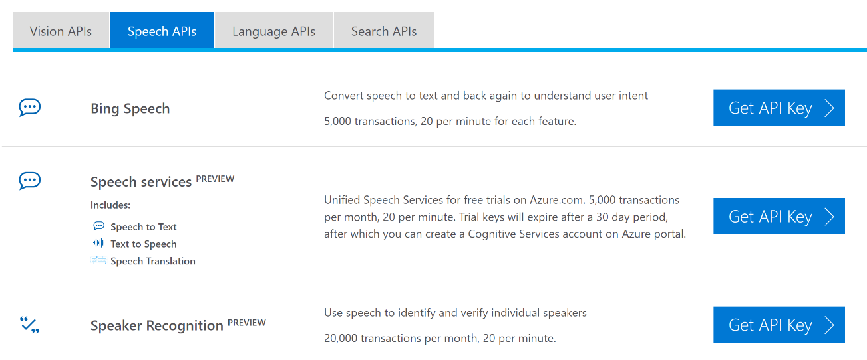
Notes:
//optional slide to describe how you get Cog Services. Get API key and then insert into your app.
//example here: https://github.com/Microsoft/computerscience/blob/master/Labs/Azure%20Services/Azure%20Storage/Azure%20Storage%20and%20Cognitive%20Services%20(Node).md
So, I’m going to show you how to use Azure Speech services! Which do both speech to text (and text to speech) and translation.
Custom speech service is a slightly different process, but also easy, and builds on the speech to text service.

